Slide 1



BYOC

Slide 2



Saubhagya Chopra
Ganpathi Natarajan
Team Members:
Venkatesh NP
Abhishree Verma

Slide 3
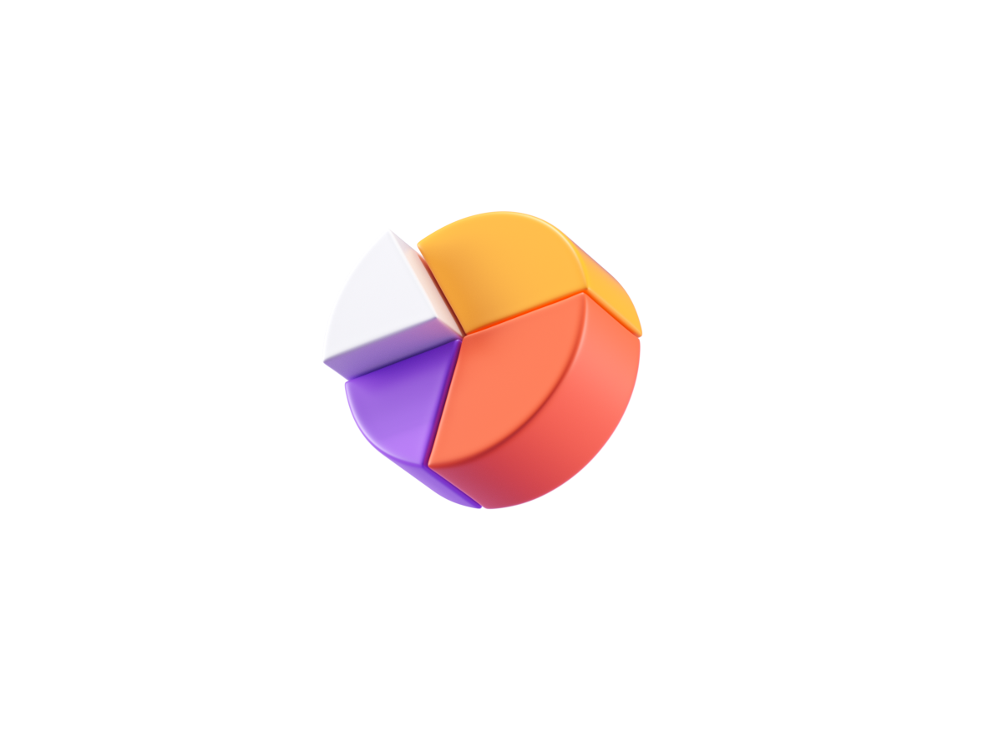
Agenda
Introduction
Problem Statement
Motivation
Existing System
Literature Survey
Objectives
Proposed system
System Design
Detailed Design
Module Design
Tech Stack used
Demo

Slide 4
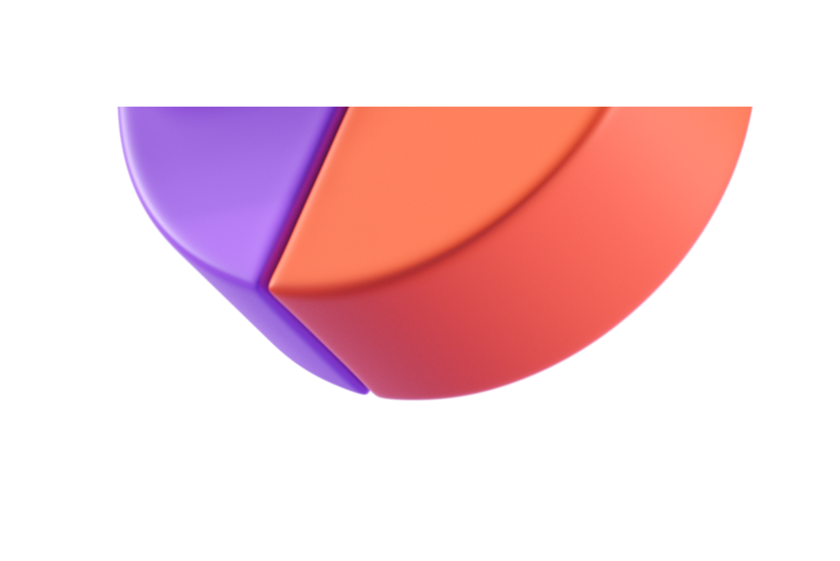
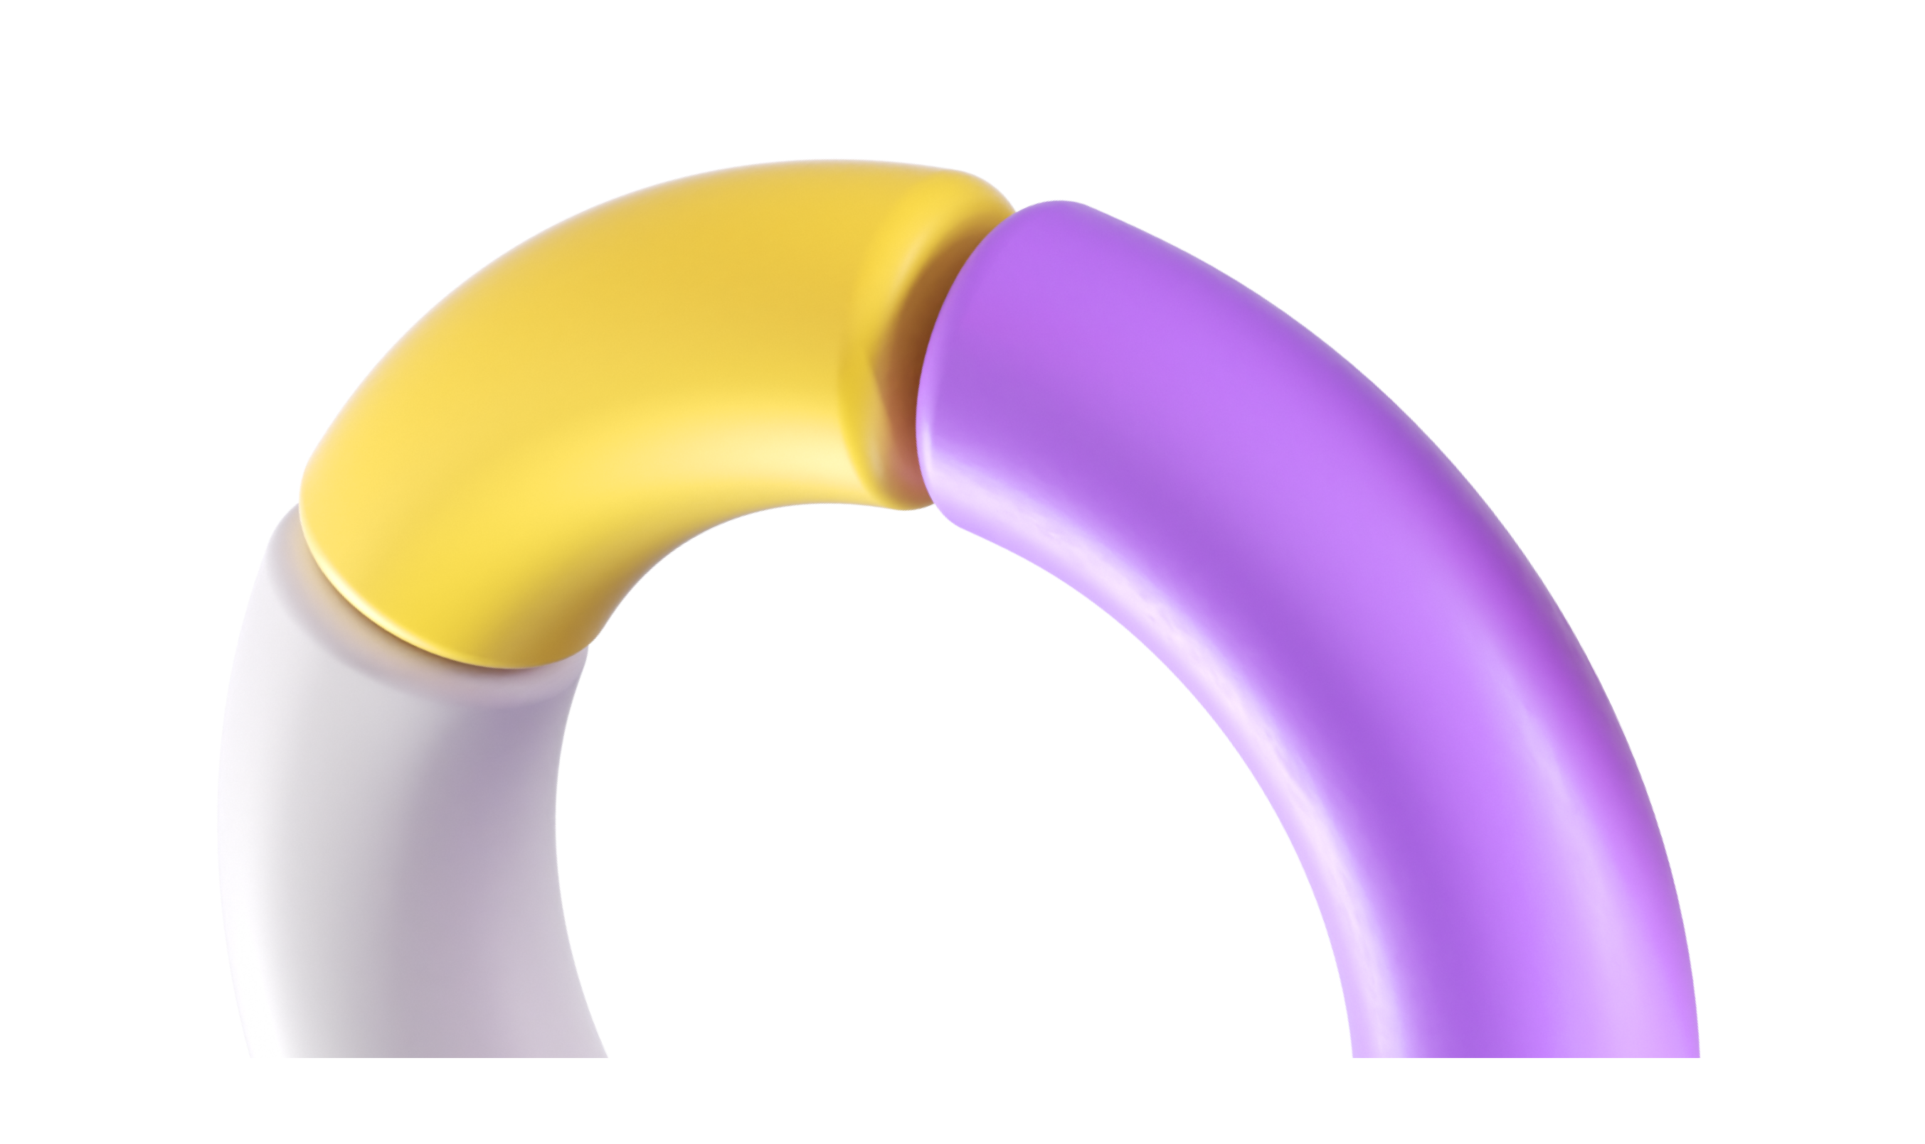
Introduction
We are excited to share insights today on a crucial aspect of modern software development—streamlining deployment workflows and enhancing flexibility in DevOps through cloud-based automation. As technology evolves at a rapid pace, the need for efficient and agile development processes becomes increasingly evident. In this presentation, we will explore the challenges faced in traditional deployment approaches, delve into the principles of DevOps, and highlight how cloud-based automation serves as a transformative force. Let's embark on a journey to understand the significance of this paradigm shift and discover how it empowers teams to deliver software with speed, reliability, and adaptability.
2024

Slide 5

Problem Statement
The challenge lies in the intricate and error-prone nature of traditional DevOps practices, hindering deployment workflows with delays and mistakes. Startups and smaller organizations, constrained by resources, face difficulty in accessing and implementing DevOps. By simplifying workflows, improving flexibility, and maximizing resource utilization, our initiative aims to make DevOps accessible, streamlining deployment procedures for increased efficiency and resilience, particularly beneficial for smaller teams in the dynamic landscape of software development.
​
2024

Slide 6

Motivation
Traditional deployment processes are often manual, time-consuming, and error-prone.
They can lead to delays, inconsistencies, and increased operational costs.
DevOps aims to address these challenges by automating the deployment process and fostering collaboration between teams.
Cloud-based automation offers a scalable and flexible solution to achieve these goals.
By streamlining deployment workflows and enhancing flexibility, organizations can achieve faster time-to-market, improve software quality, and increase customer satisfaction.
By streamlining deployment workflows and enhancing flexibility, organizations can achieve faster time-to-market, improve software
2024

Slide 7


Existing System
 | Traditional Manual Deployment Process
Manual deployment processes involve multiple manual steps, including configuration, provisioning, and deployment | The lack of automation hinders scalability, agility, and collaboration between development and operations teams. | Traditional systems often rely on on-premises infrastructure, which limits scalability and flexibility.
These steps are prone to errors, delays, and inconsistencies. | It can lead to longer deployment cycles and increased operational costs. | This can hinder innovation and adaptability in rapidly changing business environments.
2024
COMPANY NAME

Slide 8
Detailed Literature Survey
Paper-1
TITLE OF THE PAPER:
The paper is titled "A Cloud automation platform for flexibility in applications and resources provisioning" and is authored by M. Boschetti, Vito Baglio, P. Ruiu, and O. Terzo. It was published in 2015.
METHODOLOGY:
The methodology used in the paper involves the development and implementation of the ALM Automation Platform over the CHEF framework. The platform is designed to address the challenges of cloud automation by providing speed and flexibility in developing and managing cloud software. The authors also discuss the implementation of a commercial private cloud solution and the benefits and outcomes of the ALM Automation Platform.
OBSERVATION:
The paper presents an innovative ALM Automation Platform based on open source tools and automation for managing applications' lifecycle. It aims to provide speed and flexibility in developing and managing cloud software, addressing the challenges of cloud automation. The platform's implementation and benefits are discussed, focusing on services virtualization for Public Administration.
RESULTS:
The paper does not provide any specific results or data from experiments or evaluations.
2024
COMPANY NAME

Slide 9
Paper-2
TITLE OF THE PAPER:
The author of the paper is Sagar Narendrasing Deshmukh, and the title of the paper is "A System for Application Deployment Automation on Cloud Environment"
METHODOLOGY:
The paper proposes a system for automating application deployment on a cloud environment using a web-based application and a server-agent communication model. The system installs and configures software on multiple environments and uses a publish-subscribe pattern for communication. The paper also discusses related work and the benefits of automating deployment methods on a cloud environment .
OBSERVATION:
The proposed system for automating application deployment on a cloud environment aims to streamline the process, reduce time and cost, and simplify deployment for system operation teams ,[object Object],.
RESULTS:
Based on the information provided in the paper, the proposed system for automating application deployment on a cloud environment aims to streamline the process, reduce time and cost, and simplify deployment for system operation teams. The system utilizes a web-based application and a server-agent communication model to install and configure software on multiple environments, including development, production, quality analysis, and demo ,[object Object],.
2024

Slide 10
Paper-3
TITLE OF THE PAPER:
The paper is titled "Automation of Microservices Application Deployment Made Easy By Rundeck and Kubernetes" and the authors are Harika Rajavaram, Vineet Rajula, and B. Thangaraju
METHODOLOGY:
The paper explores the different procedures of deploying microservices in CI/CD pipeline using Rundeck, Docker containers, Docker-Compose and Kubernetes. The authors weigh the pros and cons of these orchestration methods, explaining suitable use cases for each one of them. They also provide an architecture diagram of the procedure for a generic web application as microservices and elaborate on the CI/CD Jenkins Pipeline. The different tools used in different phases of the pipeline are mentioned in Table 1
OBSERVATION:
The paper observes that Kubernetes is the most efficient way to deploy microservices to achieve high availability and scalability. It also discusses the benefits of microservices architecture and continuous deployment practices in improving the productivity of organizations.
RESULTS:
The paper concludes that Kubernetes, with its integration plugin with Rundeck, appears to be the best practical approach to microservices orchestration based on the implementation work done in the study. It emphasizes the high availability and scalability achieved through Kubernetes deployment of microservices.
2024

Slide 11
Paper-4
TITLE OF THE PAPER:
Author names: Roksoliana Basa, Dariusz Mrozek, Orest Lavriv, and Olena Krasko.Title of the paper: Automation Process of Telecommunication Networks Deployment in Microsoft Azure Cloud Technology.Year: 2020.
METHODOLOGY:
The methodology involves designing a simulation model of the network infrastructure using Infrastructure as Code (IaC) to demonstrate the benefits of automation compared to manual deployment. Additionally, the authors analyze the behavior of virtual machines within the deployed virtual network in terms of CPU utilization.
OBSERVATION:
The observation reveals that different categories of virtual machines exhibit varying levels of CPU usage and resource utilization, indicating the importance of considering the minimum number of users, potential growth, and the applications deployed on them. Additionally, the study highlights the cost-effectiveness of using specific virtual machine categories under different user request conditions, emphasizing the need for careful consideration when selecting virtual machine types for specific workloads.
RESULTS:
The results include insights into CPU utilization and performance of different types of virtual machines within the deployed virtual network, demonstrating the feasibility and benefits of using Infrastructure as Code (IaC) for cloud system automation.
2024

Slide 12
Paper-5
TITLE OF THE PAPER:
The author of the paper is Sriniketan Mysari, and the title of the paper is "Continuous Integration And Continuous Deployment Pipeline Automation Using Jenkins Ansible." The year of the paper is 2020.
METHODOLOGY:
The methodology involves continuous integration using Jenkins and deployment using the Ansible tool.
OBSERVATION:
The paper highlights the efficiency and time-saving benefits of automation in building and hosting web applications using Jenkins and Ansible. It emphasizes the reduction in deployment time and improved software quality through continuous integration and deployment.
RESULTS:
The result is an efficient and optimized way of building and hosting web applications, leading to faster development with better software quality.
2024

Slide 13
Paper-6
TITLE OF THE PAPER:
The authors of the paper are Lukas Harzenetter, Uwe Breitenbücher, Frank Leymann, Karoline Saatkamp, Benjamin Weder, and Michael Wurster. The title of the paper is "Automated Generation of Management Workflows for Applications Based on Deployment Models" and it was published in 2019.
METHODOLOGY:
The methodology involves consuming declarative deployment models and enriching the modeled components with component-specific management operations provided by reusable component types. Based on this enrichment, an executable management workflow is generated to orchestrate these operations for executing the desired management functionality.
OBSERVATION:
The paper presents a practical approach to automate the generation of management workflows for various functionalities based on declarative deployment models, significantly reducing the need for manual implementation and technical expertise. The feasibility of the approach was validated through a prototypical implementation and case studies, demonstrating its practical application for management use cases.
RESULTS:
The practical feasibility of the approach was validated through a prototypical implementation based on the TOSCA standard and the OpenTOSCA ecosystem, along with the presentation of two case studies demonstrating practical management use cases.
2024

Slide 14
Paper-7
TITLE OF THE PAPER:
The paper is titled "Self-Configured Workflow Platform for MapReduce Job Execution in Cloud Environment" and is authored by Muntadher Saadoon and Novia Admodisastro. It was published in 2022.
METHODOLOGY:
The methodology involves conducting experiments on a real Hadoop cloud-based cluster to measure the execution time of the developed workflow system in comparison to the native MapReduce application.
OBSERVATION:
The results showed that the proposed platform achieved slightly similar execution times compared to the native application, with only a slight difference incurred due to additional interactions with the database server. The platform's features enable simplicity in managing, collaborating, and reusing the workflows, significantly reducing the time and effort needed in deploying MapReduce applications.
RESULTS:
The results show that the execution times of the self-configured workflow platform are comparable to the native application when evaluated in experiments on a real Hadoop cloud-based cluster. The average time cost in the native MapReduce is 282.72sec while the proposed workflow is 302.88sec.
2024

Slide 15
Paper-8
TITLE OF THE PAPER:
"Revolutionizing Cloud Infrastructure Management: Streamlined Provisioning and Monitoring with Automated Tools and User-Friendly Frontend Interface"
METHODOLOGY:
The paper addresses the challenges faced by large organizations in streamlining cloud infrastructure management and provisioning, particularly the lack of an end-to-end system for handling cloud infrastructure provisioning requests and maintaining transparency for users.
OBSERVATION:
The authors propose a software solution that automates cloud infrastructure provisioning through a user-friendly interface and integrates GitHub Actions in the CI/CD pipeline for efficient resource management.
RESULTS:
The results show that the execution times of the self-configured workflow platform are comparable to the native application when evaluated in experiments on a real Hadoop cloud-based cluster.
2024

Slide 16
Paper-9
TITLE OF THE PAPER:
Zhang, X., & Li, J. (2015). The research and implementation of cloud computing platform based on docker. In 2015 International Conference on Cyber-Enabled Distributed Computing and Knowledge Discovery (CyberC) (pp. 1-4). IEEE. DOI: 10.1109/CyberC.2015.43.
METHODOLOGY:
The authors of the paper used an online questionnaire to gather data. The first part of the study reached 68 graduate students from a study program on informatics engineering, and the second one 120 professional software developers 1. The paper aims to characterize the activities around two particular kinds of Infrastructure-as-Code (IaC) specification—Dockerfiles and docker-compose.yml files. The authors seek to know how they can be better supported and therefore study also what approaches and tools practitioners employ 1. The study is focused on characterizing the activities around two particular kinds of IaC specification—Dockerfiles and docker-compose.yml files. The authors seek to know how they can be better supported and therefore study also what approaches and tools practitioners employ 1. The paper does not provide any details about the methodology used in the study 1.z
The study found that most of the activities of the process of developing a Dockerfile are perceived as time-consuming, especially when the respondents are beginners with this technology. The authors also found that solving issues using trial-and-error approaches is very common and that many developers do not use ancillary tools to support the development of Dockerfiles and docker-compose.yml files 1.
OBSERVATION:
RESULTS:
​
The results show that most of the activities of the process of developing a Dockerfile are perceived as time-consuming, especially when the respondents are beginners with this technology.
2024

Slide 17
Paper-10
TITLE OF THE PAPER:
Docker: lightweight Linux containers for consistent development and deployment. Linux Journal. 2014. The authors of the paper are not mentioned in the abstract. The paper was published in IEEE Access in December 2021 1.
METHODOLOGY:
This paper presents the findings of a survey conducted with developers to explore their approaches, tools, and activities related to Docker and Docker-Compose specifications. The study aimed to enhance the support for Dockerfiles and docker-compose.yml files, addressing technical challenges and exploring collaborative aspects. The questionnaire was designed using Google Forms, and the results were stored in a spreadsheet with shared access to the researchers. The dataset and analysis scripts are also made available as part of the replication package.
OBSDERVATION:
The study found that developers generally have a neutral sentiment towards reading Docker-Compose specifications, with a slight skewness towards an agreement sentiment. The questionnaire was designed to be clear and direct, with a restricted set of open-ended questions to obtain rich free-text responses.
RESULTS:
​
​
Overall, the study provides valuable insights into how cloud computing and IaC technologies, such as Docker, have revolutionized software system development and deployment.
2024

Slide 18
Paper-11
TITLE OF THE PAPER:
"The research and implementation of cloud computing platform based on docker" by Zhang, X., & Li, J.
METHODOLOGY:
This paper discusses Docker, a technology that offers lightweight and nimble Linux containers as an alternative to traditional virtual machines. Docker solves the problem of "dependency hell" by packaging applications and their dependencies in isolated containers based on LXC technology. These containers are portable and can be easily deployed across different environments.
OBSDERVATION:
The document highlights the ease of creating new Docker images by layering on top of existing ones, and it mentions the growing adoption of Docker in the Linux community and its progress towards becoming production-ready, with Red Hat announcing support for Docker in their Red Hat Enterprise Linux 7.
RESULTS:
​
​
Overall, Docker is shown to be a valuable tool for assembling and sharing applications in cloud computing environments.
2024

Slide 19
Paper-12
TITLE OF THE PAPER:
The title of the paper is "End to End Automation On Cloud with Build Pipeline: The case for DevOps in Insurance Industry Continuous Integration, Continuous Testing, and Continuous Delivery" by Mitesh Soni, published in 2014 ,
METHODOLOGY:
The paper presents a proof of concept for designing an effective framework for continuous integration, continuous testing, and continuous delivery to automate the source code compilation, code analysis, test execution, packaging, infrastructure provisioning, deployment, and notifications using build pipeline concept ,
OBSDERVATION:
The objective of the paper is to showcase the benefits of end-to-end automation in application delivery lifecycle using a combination of DevOps culture and cloud environment ,
RESULTS:
​
​
The implemented proof of concept showcases various benefits of end-to-end automation in application delivery lifecycle using a combination of DevOps culture and cloud environment .
2024

Slide 20
Paper-13
TITLE OF THE PAPER:
The title of the paper is "Survey of Automation Practices in Model-Driven Development and Operations" authored by Christophe Ponsard and Valery Ramon, published in 2022 ,
METHODOLOGY:
The methodology involved gathering and analyzing case studies from the authors' experience and the literature, covering a variety of domains and requirements. The approach was not exhaustive and did not follow a systematic mapping survey, but rather focused on specific DevOps support for Model-Driven Development (MDD) and the use of bots .
OBSDERVATION:
The paper aimed to survey automation needs and practices for Model-Driven Development (MDD) using a DevOps approach, with a focus on specific automation related to MDD and the use of bots. It also highlighted key challenges and identified future research directions in this area .
RESULTS:
​
​
The paper identified a number of automation tasks specific to MDD, including model analysis and transformation, and classified them according to a typical DevOps lifecycle. The survey also revealed that most reported automation activities relate to the Dev phase, with few activities reported in Ops .
2024

Slide 21
Paper-14
TITLE OF THE PAPER:
The title of the paper is "Revolutionizing Cloud Infrastructure Management: Streamlined Provisioning and Monitoring with Automated Tools and User-Friendly Frontend Interface" and the authors are Shreyas Kamath, Manohara Pai M.M, Shankar Vignesh, and Darshan G. The year of publication is not mentioned in the PDF file.
METHODOLOGY:
The methodology involves the use of Infrastructure as Code (IaC) with GitHub Actions to automate the creation, deployment, and retirement of cloud infrastructure. The paper also proposes a simple software solution with a frontend interface and dashboard built on top of Grafana API to streamline the process of provisioning and monitoring cloud resources.
OBSDERVATION:
The obervation of the paper is to demonstrate the feasibility of designing an effective framework for continuous integration, testing, and delivery of cloud resource provisioning. It aims to showcase the use of automated tools and a user-friendly frontend interface to streamline the process of provisioning and monitoring cloud infrastructure.
RESULTS:
​
​
The paper presents a software solution that utilizes GitHub Actions in the CI/CD pipeline to speed up the process of provisioning cloud infrastructure through a simple frontend. Additionally, it demonstrates the tracking of resource utilization of provisioned resources through a dashboard, facilitating quick delivery of cloud infrastructure.
2024

Slide 22
Paper-15
TITLE OF THE PAPER:
The paper is titled "The Collaboration of DevOps Automation and SOA to Accelerate Software Development Culture" and is written by Fakhri Nurullah, Gunawan Wang, Emil Robert Kaburuan, and Ahmad Nurul Fajar in 2018.
METHODOLOGY:
The authors employed a research methodology that involved interviewing several stakeholders from the IT team to understand the dynamics of the transformation of application production within the corporate environment. The results of these interviews were documented, analyzed, and evaluated to obtain a comparison of the old system with proposed new solutions. Additionally, the paper presents a theoretical framework for building software development culture, emphasizing the role of SOA in communicating business processes and user functions in running business operations ,
OBSDERVATION:
The paper discusses the challenges encountered in traditional software development methodologies, such as the waterfall model, including the inability to make changes until after the application product is launched . It also highlights the interruptions in communication procedures and the slow application delivery and feedback acceptance, which impact the company's business processes and competitiveness,. The authors propose a collaborative and communicative model as a new software development culture to accelerate enterprise 2.0 constructive ,
RESULTS:
​
​
The implementation of the proposed model demonstrated the potential to accelerate the application release process and improve service delivery to clients in the tourism industry.
2024

Slide 23
SL.No | Title of the paper | Problem Addressed | Authors Approach/ Method | Results
1 | "A Cloud Automation Platform for Flexibility in Applications and Resources Provisioning" | The paper addresses the challenges faced by cloud technologies, particularly in the decoupling of application-level and infrastructure-level in both the development and runtime phases, leading to poor Quality of Service (QoS) in cloud services | The authors address the challenges faced by cloud technologies, particularly in the decoupling of application-level and infrastructure-level, and propose an ALM Automation Platform over CHEF framework to manage services virtualization for Public Administration. Additionally, they discuss the implementation of a commercial private cloud solution to build separate and autonomous virtual data centers for different domains of Public Administration | The paper does not explicitly mention specific results or outcomes. However, it presents the ALM Automation Platform as a solution to provide speed and flexibility to teams involved in developing and managing cloud software, based on open source tools and automation to manage applications' lifecycle.
2 | "A System for Application Deployment Automation on Cloud Environment" | The paper addresses the problem of automated provisioning and deployment of applications in cloud environments, focusing on reducing costs and time associated with managing and maintaining applications | The authors approach the problem by examining different deployment methods for various types of application stacks on PaaS and IaaS solutions. They also focus on the challenges faced by operational teams in managing and deploying applications on different environments, and propose an automated deployment system for applications on various cloud environments | The paper presents the evaluation and recommendations for deployment approaches based on the specific requirements of applications. It also discusses the challenges addressed by the 4CaaSt project for comprehensive management of applications and services in a PaaS

Slide 24
SL.No | Title of the paper | Problem Addressed | Authors Approach/ Method | Results
3 | "Automation of Microservices Application Deployment Made Easy By Rundeck and Kubernetes" | The paper addresses the challenges faced by cloud technologies, particularly in the decoupling of application-level and infrastructure-level in both the development and runtime phases, leading to poor Quality of Service (QoS) in cloud services | The paper addresses the challenge of deploying a powerful, easy to scale, and flexible application to compete with the huge volume of applications managed on platforms like Google Play Store. It proposes microservices architecture and continuous deployment practices as solutions to improve the productivity of organizations | The study concludes that Kubernetes, integrated with Rundeck, is the most efficient method for deploying microservices to achieve high availability and scalability. It also discusses the benefits of microservices architecture and continuous deployment practices in improving organizational productivity
4 | "Automation Process of Telecommunication Networks Deployment in Microsoft Azure Cloud Technology" | The paper addresses the need for efficient and automated deployment of telecommunication networks in Microsoft Azure Cloud, utilizing Infrastructure as Code (IaC) to improve system reliability and operational tasks. | The authors propose a method of cloud system automation for network deployment using IaC and analyze the behavior of virtual machines within a deployed virtual network in terms of CPU utilization to demonstrate the benefits of using IaC in comparison with manual actions. | The results include insights into CPU utilization and performance of different types of virtual machines within the deployed virtual network, demonstrating the feasibility and benefits of using Infrastructure as Code (IaC) for cloud system automation.

Slide 25
SL.No | Title of the paper | Problem Addressed | Authors Approach/ Method | Results
5 | "Continuous Integration And Continuous Deployment Pipeline Automation Using Jenkins Ansible." | The paper addresses the challenge of saving time and reducing errors in integration and deployment processes for developing companies. | The author's approach involves using Jenkins for continuous integration and Ansible for deployment automation to save time and improve efficiency in software development. | The result is an efficient and optimized way of building and hosting web applications, leading to faster development with better software quality.
6 | "Automated Generation of Management Workflows for Applications Based on Deployment Models" | The paper addresses the problem of automating the management of deployed applications, particularly for holistic management processes that affect multiple components deployed in different environments. | The authors propose an approach to automatically generate executable management workflows based on the declarative deployment model of an application, significantly reducing the effort for automating holistic management processes. | The practical feasibility of the approach was validated through a prototypical implementation based on the TOSCA standard and the OpenTOSCA ecosystem, along with the presentation of two case studies demonstrating practical management use cases.
7 | "Self-Configured Workflow Platform for MapReduce Job Execution in Cloud Environment" | The paper addresses the manual configurations of Hadoop MapReduce framework parameters, which expose to human errors and lead to performance overhead and resource consumption penalties. | The authors propose a self-configured workflow platform with a user-friendly collaborating environment that provides automated setups of the framework parameters to obtain ideal performance compared to the native deployment of Hadoop MapReduce. | The results show that the execution times of the self-configured workflow platform are comparable to the native application when evaluated in experiments on a real Hadoop cloud-based cluster.

Slide 26
SL.No | Title of the paper | Problem Addressed | Authors Approach/ Method | Results
8 | "Revolutionizing Cloud Infrastructure Management: Streamlined Provisioning and Monitoring with Automated Tools and User-Friendly Frontend Interface" | The paper addresses the challenges faced by large organizations in streamlining cloud infrastructure management and provisioning, particularly the lack of an end-to-end system for handling cloud infrastructure provisioning requests and maintaining transparency for users. | The paper addresses the challenges faced by large organizations in streamlining cloud infrastructure management and provisioning, particularly the lack of an end-to-end system for handling cloud infrastructure provisioning requests and maintaining transparency for users. | The result is an efficient and optimized way of building and hosting web applications, leading to faster development with better software quality.
9 | "Developing Docker and Docker-Compose Specifications: A Developers’ Survey" | The paper aims to characterize the activities around two particular kinds of Infrastructure-as-Code (IaC) specification—Dockerfiles and docker-compose.yml files | The authors seek to know how they can be better supported and therefore study also what approaches and tools practitioners employ. They used an online questionnaire to gather data. The first part of the study reached 68 graduate students from a study program on informatics engineering, and the second one 120 professional software developers | The results show that most of the activities of the process of developing a Dockerfile are perceived as time-consuming, especially when the respondents are beginners with this technology.
10 | Docker: lightweight Linux containers for consistent development and deployment. Linux Journal. 2014. | This paper presents the findings of a survey conducted with developers to explore their approaches, tools, and activities related to Docker and Docker-Compose specifications. | The authors seek to know how they can be better supported and therefore study also what approaches and tools practitioners employ. | Overall, the study provides valuable insights into how cloud computing and IaC technologies, such as Docker, have revolutionized software system development and deployment.

Slide 27
SL.No | Title of the paper | Problem Addressed | Authors Approach/ Method | Results
11 | "End to End Automation On Cloud with Build Pipeline: The case for DevOps in Insurance Industry Continuous Integration, Continuous Testing, and Continuous Delivery" | The paper addresses the need for the insurance industry to better respond to dynamic market requirements, achieve faster time to market for new initiatives and services, and support innovative ways of customer interaction through end-to-end automation on the cloud with build pipeline . | The authors approach the problem by proposing a proof of concept for end-to-end automation using a combination of DevOps culture and cloud environment, with a focus on open source tools . | The implemented proof of concept showcases various benefits of end-to-end automation in application delivery lifecycle using a combination of DevOps culture and cloud environment.
12 | "Survey of Automation Practices in Model-Driven Development and Operations" | The paper addressed the need for automation in Model-Driven Development (MDD) and the challenges related to the use of bots in a model-driven context . | The authors approached the survey by gathering and analyzing case studies from their own experience and the literature, covering a variety of domains and requirements, to identify specific DevOps support for MDD and the use of bots . | The survey identified specific automation tasks related to MDD and classified them according to a typical DevOps lifecycle, highlighting the need for more bot support in MDD .
13 | "Revolutionizing Cloud Infrastructure Management: Streamlined Provisioning and Monitoring with Automated Tools and User-Friendly Frontend Interface" | The paper addresses the need for streamlining and automating the provisioning and monitoring of cloud infrastructure in large organizations. | The authors propose a software solution that integrates Infrastructure as Code (IaC) with GitHub Actions and a user-friendly frontend interface to automate and streamline cloud resource provisioning and monitoring. | The result is a streamlined process for provisioning cloud infrastructure and tracking resource utilization through a user-friendly dashboard.

Slide 28
SL.No | Title of the paper | Problem Addressed | Authors Approach/ Method | Results
14 | "The Collaboration of DevOps Automation and SOA to Accelerate Software Development Culture" | The paper addresses the need for a more collaborative and communicative software development culture to accelerate enterprise constructive and overcome the challenges of traditional methodologies. | The authors propose a collaborative approach by integrating DevOps and SOA to accelerate software development culture and minimize miscommunication between developers and users. | The implementation of the proposed model demonstrated the potential to accelerate the application release process and improve service delivery to clients in the tourism industry.
15 | The research and implementation of cloud computing platform based on docker" | This paper discusses Docker, a technology that offers lightweight and nimble Linux containers as an alternative to traditional virtual machines | Docker solves the problem of "dependency hell" by packaging applications and their dependencies in isolated containers based on LXC technology. These containers are portable and can be easily deployed across different environments. | Overall, Docker is shown to be a valuable tool for assembling and sharing applications in cloud computing environments.

Slide 29

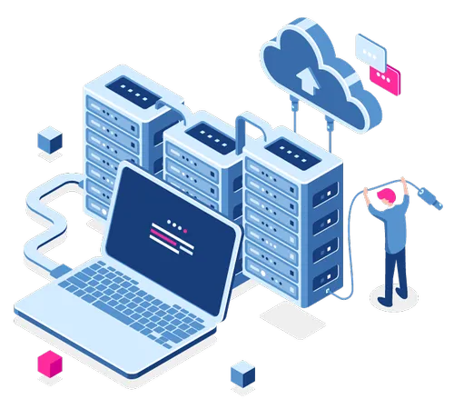

Objectives
The objective is to streamline deployment workflows and enhance flexibility in DevOps through cloud-based automation.
This will result in faster deployment cycles, improved software quality, and increased agility.
The goal is to achieve cost savings, scalability, and collaboration between development and operations teams.
This will enable organizations to respond quickly to market demands and gain a competitive edge.
The objective is to leverage cloud-based automation to optimize the deployment process, reduce operational costs, and increase customer satisfaction.
This will enable organizations to deliver high-quality software

Slide 30

System Requirement Specification
NON FUNCTIONAL REQUIREMENTS
FUNCTIONAL REQUIREMENTS
Infrastructure provisioning and configuration
Application deployment and release automation
Environment management
Continuous integration and continuous delivery
Monitoring and alerting
Support for different cloud providers
Fast deployment times(Performance)
Availability
Reliability
Maintainability
Interoperability
HARDWARE REQUIREMENTS
SOFTWARE REQUIREMENTS
Virtual Machine (VM) Specifications
Storage
RAM
Containerization Platform
Operating System
Cloud Management Environment
Node js

Slide 31
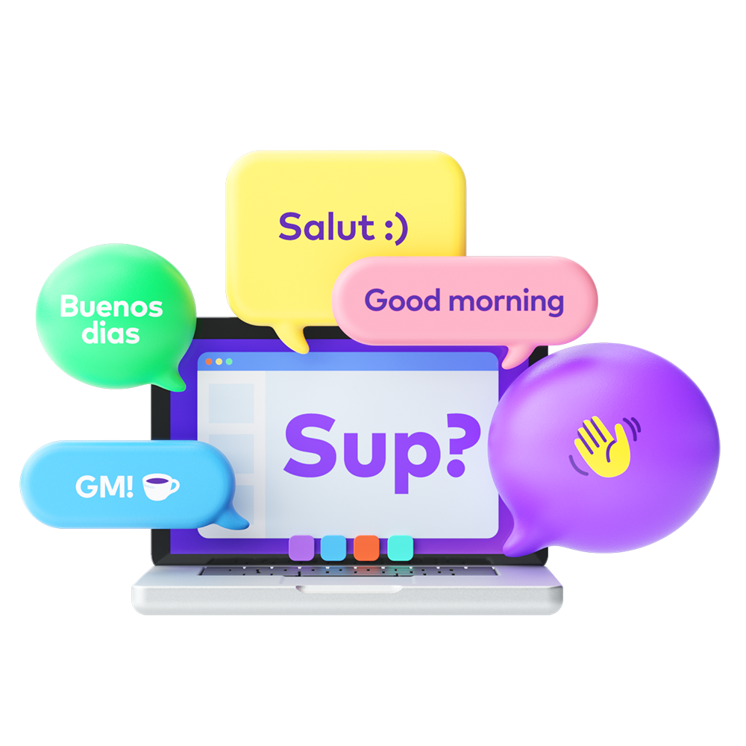

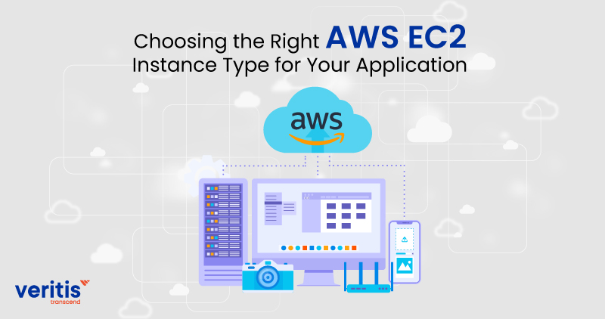
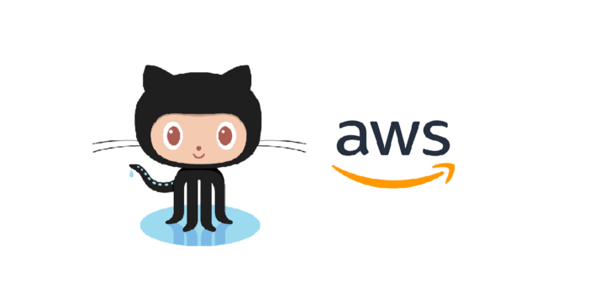
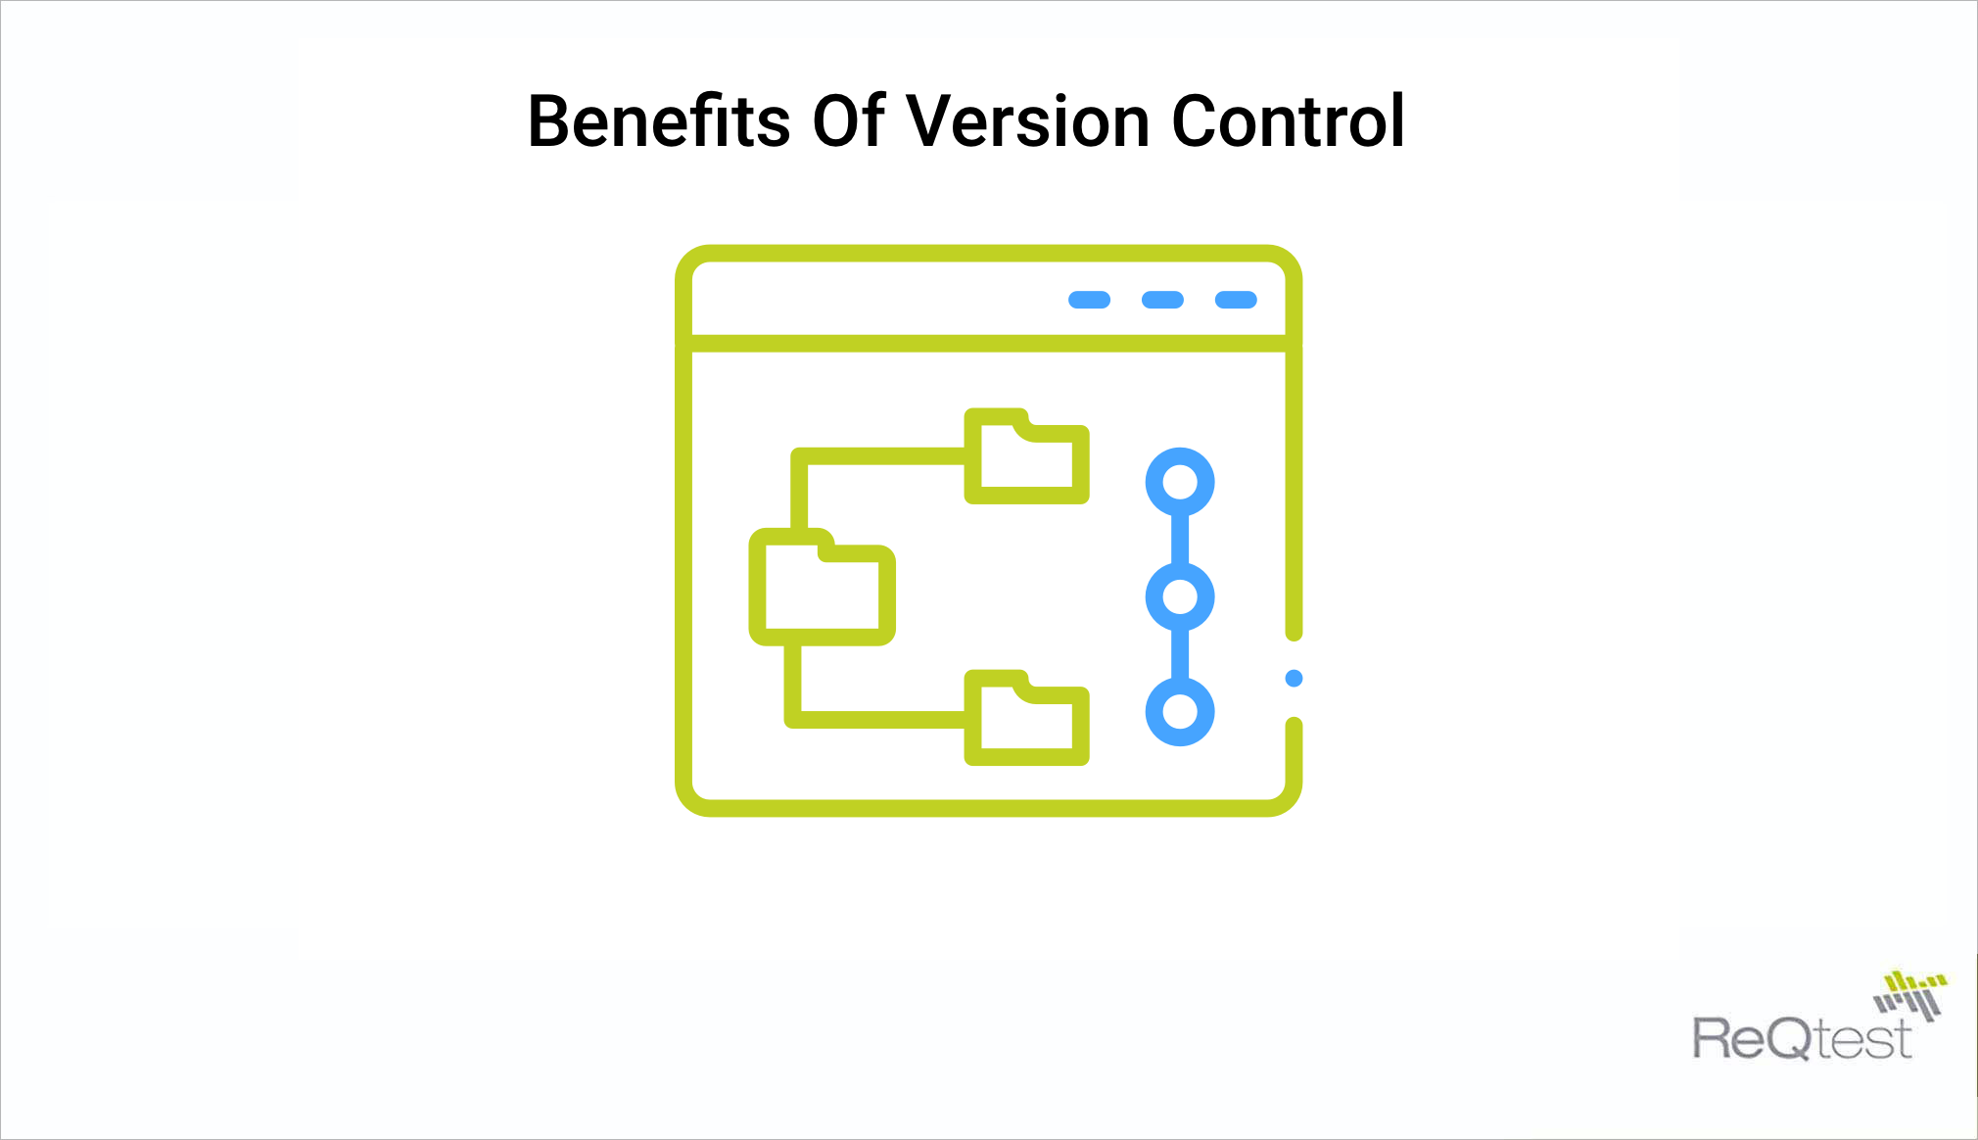
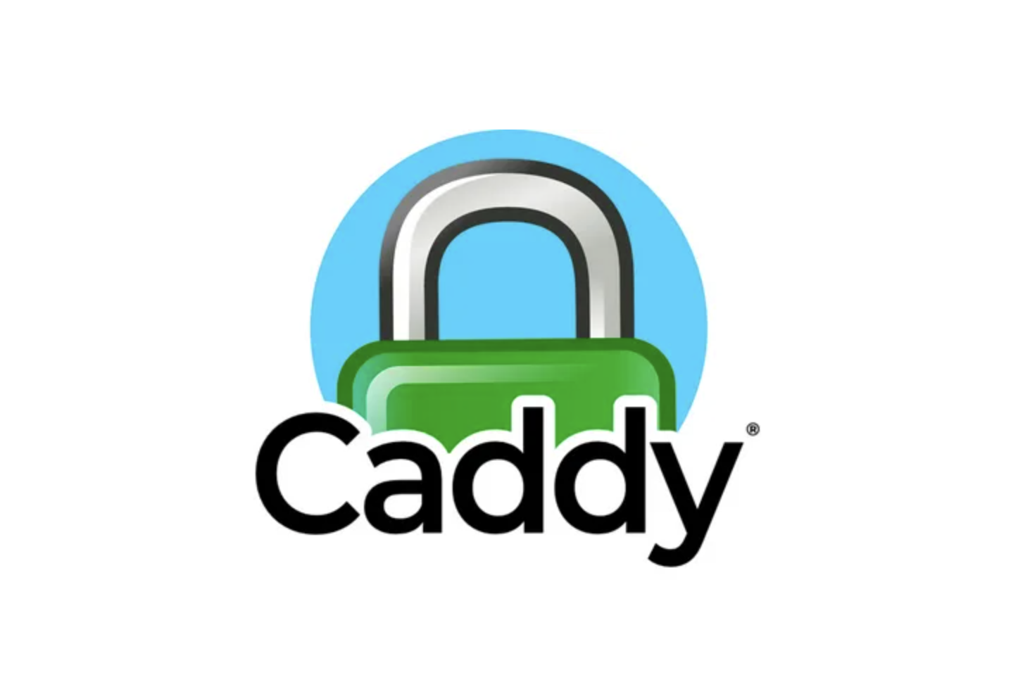


Proposed System
Proposed System
Automating the below steps mentioned .
PUSH THE CODE TO VERSION CONTROL
SYSTEM
CREATE A EC2 INSTANCE ON AWS BASED ON THE ANALYSIS.
PULL THE CODE ON THE AWS AND ANALYSE IT.
CONFIGURE THE PROXY SERVER.

Slide 32
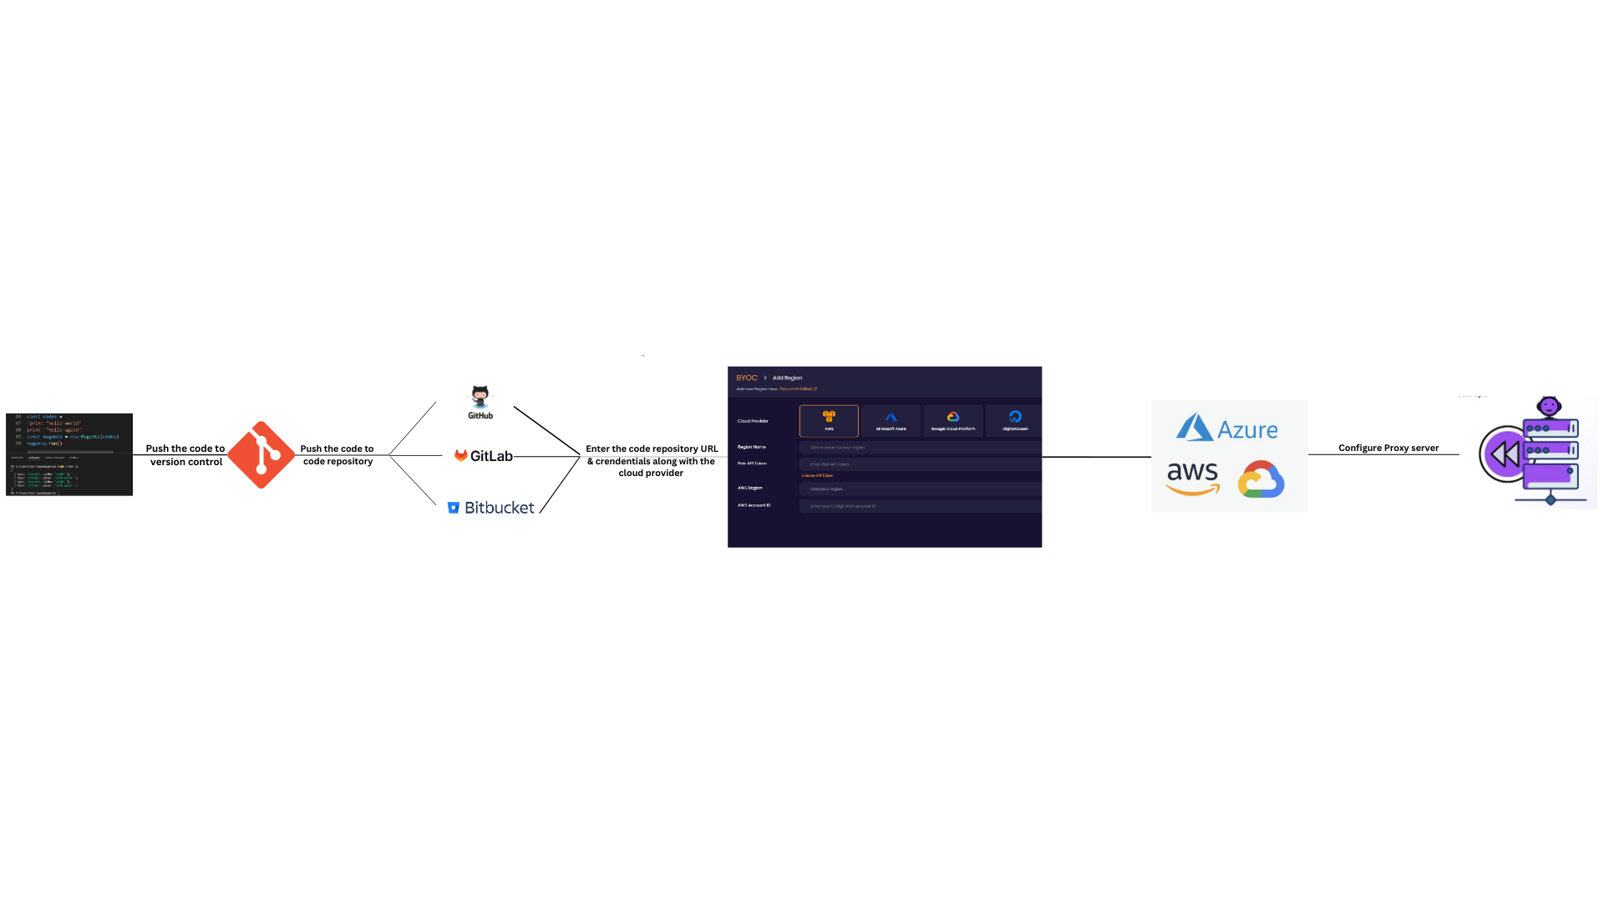
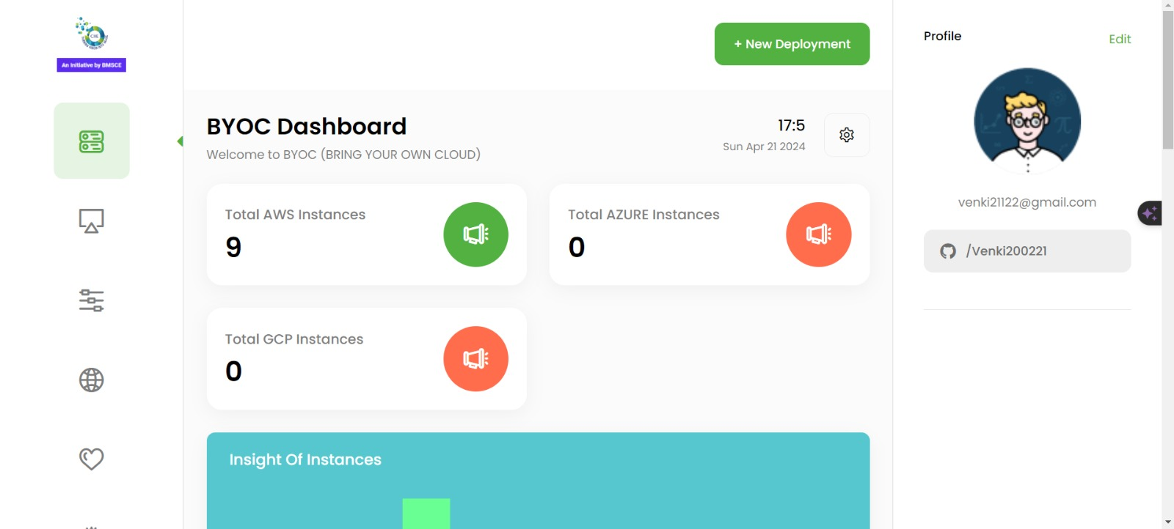
Proposed System in detail
Proposed System
Automating the below steps mentioned .
PUSH THE CODE TO VERSION CONTROL
SYSTEM
CREATE A EC2 INSTANCE ON AWS BASED ON THE ANALYSIS.
PULL THE CODE ON THE AWS AND ANALYSE IT.
CONFIGURE THE PROXY SERVER.

Slide 33
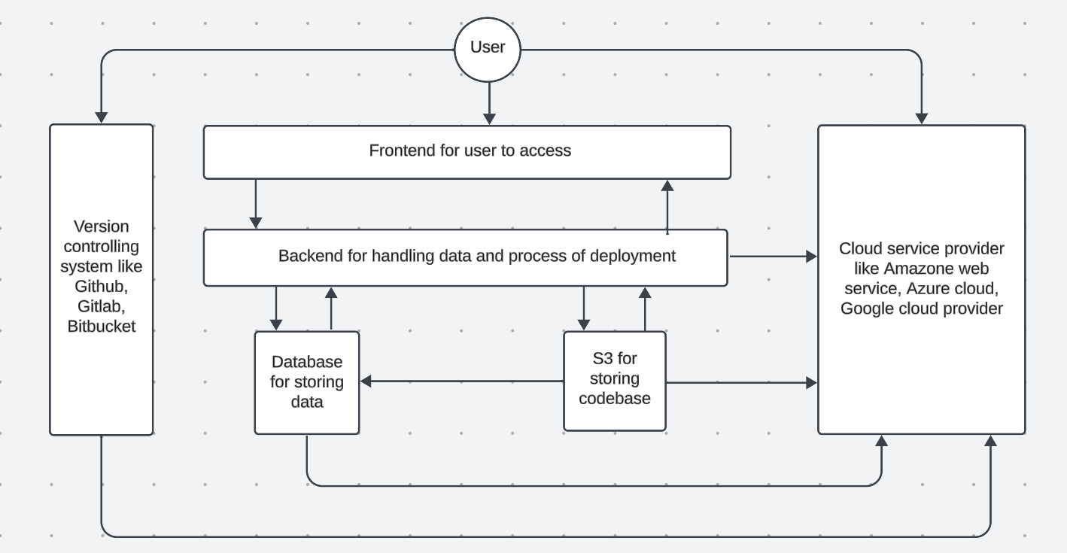
System Architecture

Slide 34


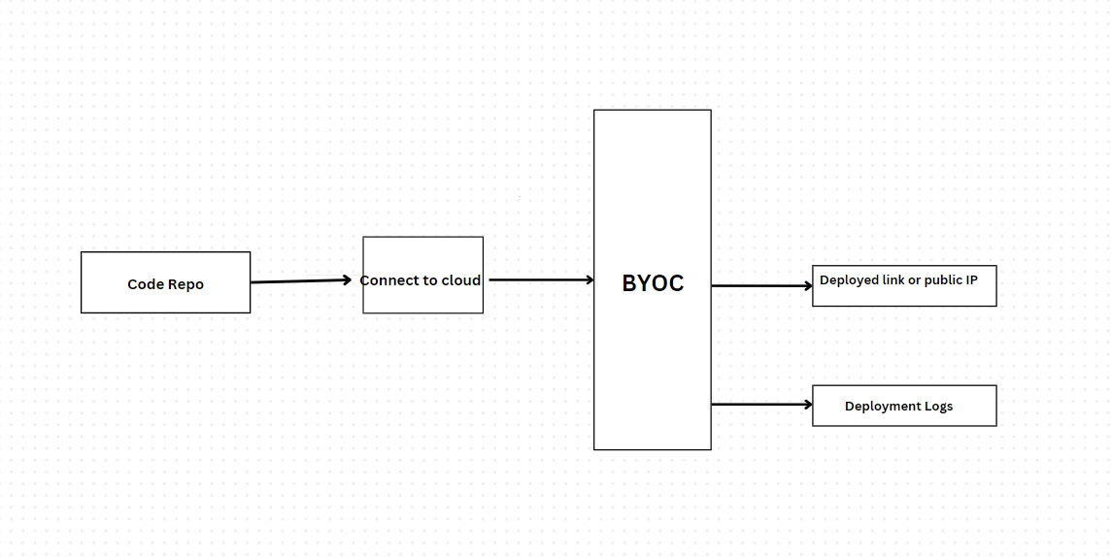

Module design

Slide 35




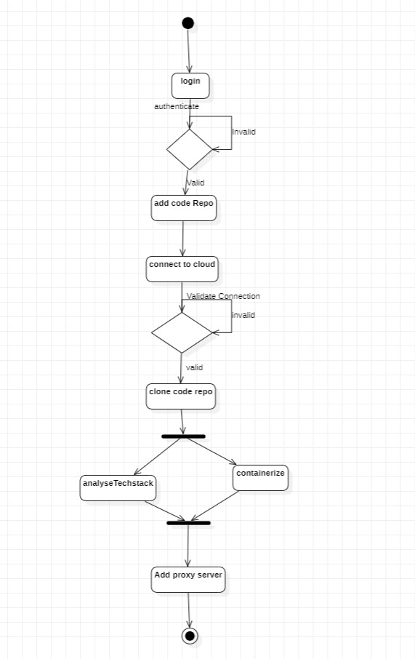
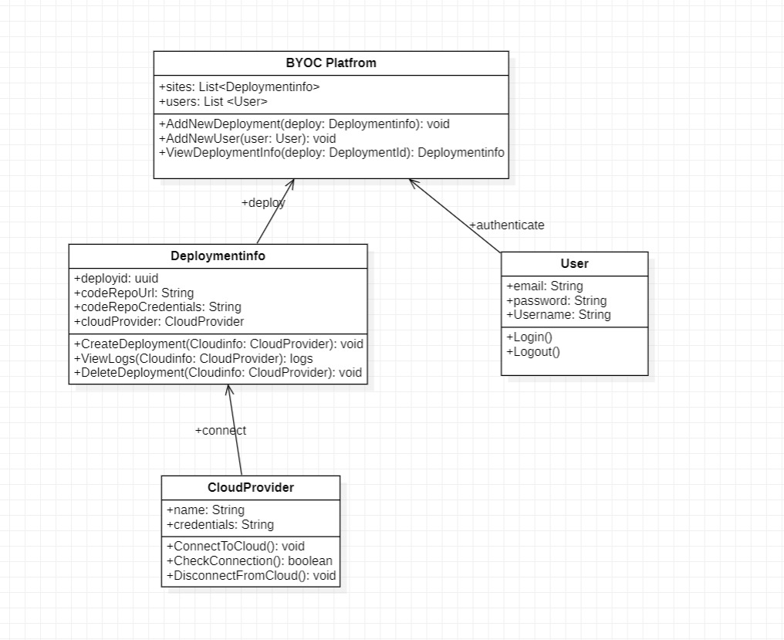

Detailed
Design
Class Diagram
Activity Diagram

Slide 36


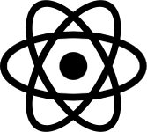


Tech Stack
Front-end: React, Redux, Material UI, Bootstrap, SCSS
Back-end: Nodejs, Express js, Github auth
Other tools: Docker, Docker-compose, Caddy server
Frameworks we support :
React
Nodejs
Django

Slide 37







Why US?
BYOC are perfect fit to you if you

Slide 38
Demo

Slide 39
References
Cretella, G., D’Aniello, G., & Esposito, A. (2015). A Cloud Automation Platform for Flexibility in Applications and Resources Provisioning. In 2015 Ninth International Conference on Complex, Intelligent, and Software Intensive Systems (pp. 1-6). IEEE. DOI: 10.1109/CISIS.2015.29.
Singh, S. K., & Singh, S. K. (2017). A System for Application Deployment Automation on Cloud Environment. In 2017 Innovations in Power and Advanced Computing Technologies (i-PACT) (pp. 1-5). IEEE. DOI: 10.1109/IPACT.2017.8245025.
Mysari, S., & Singh, S. K. (2019). Automation of Microservices Application Deployment Made Easy By Rundeck and Kubernetes. In 2019 IEEE International Conference on Electronics, Computing and Communication Technologies (CONECCT) (pp. 1-5). IEEE. DOI: 10.1109/CONECCT47791.2019.9012811.
Alqahtani, M. A., & Alghamdi, A. (2022). Automation Process of Telecommunication Networks Deployment in Microsoft Azure Cloud Technology. In 2022 3rd International Conference on Computer Science, Electrical and Information Technologies (ICCEIT) (pp. 1-5). IEEE. DOI: 10.1109/ICCEIT.2022.317.
Singh, S. K., & Singh, S. K. (2020). Continuous Integration And Continuous Deployment Pipeline Automation Using Jenkins Ansible. In 2020 International Conference on Emerging Trends in Information Technology and Engineering (ic-ETITE) (pp. 1-5). IEEE. DOI: 10.1109/ic-ETITE47903.2020.239.
2024

Slide 40
References
Alqahtani, M. A., & Alghamdi, A. (2022). Automation Process of Telecommunication Networks Deployment in Microsoft Azure Cloud Technology. In 2022 3rd International Conference on Computer Science, Electrical and Information Technologies (ICCEIT) (pp. 1-5). IEEE. DOI: 10.1109/ICCEIT.2022.317.
Saadoon, M., & Admodisastro, N. (2022). Self-Configured Workflow Platform for MapReduce Job Execution in Cloud Environment. In 2022 Applied Informatics International Conference (AiIC) (pp. 122-125). IEEE. DOI: 10.1109/AiIC54368.2022.9914603.
Kamath, S., Pai, M. M. M., Vignesh, S., & Darshan, G. (2021). Revolutionizing Cloud Infrastructure Management: Streamlined Provisioning and Monitoring with Automated Tools and User-Friendly Frontend Interface. IEEE Access, 10, 2318-2329. DOI: 10.1109/ACCESS.2021.3137671.
Reis, D., Piedade, B., Correia, F. F., & Fernandes, J. M. (2021). Developing Docker and Docker-Compose Specifications: A Developers’ Survey. IEEE Access, 10, 2318-2329. DOI: 10.1109/ACCESS.2021.3137671.
Merkel, D. (2014). Docker: lightweight Linux containers for consistent development and deployment. Linux Journal. Retrieved from 1Merkel, D. (2014). Docker: lightweight Linux containers for consistent development and deployment. Linux Journal. Retrieved from 1
2024

Slide 41
References
Cretella, G., D’Aniello, G., & Esposito, A. (2015). A Cloud Automation Platform for Flexibility in Applications and Resources Provisioning. In 2015 Ninth International Conference on Complex, Intelligent, and Software Intensive Systems (pp. 1-6). IEEE. DOI: 10.1109/CISIS.2015.29.
Saadoon, M., & Admodisastro, N. (2022). Survey of Automation Practices in Model-Driven Development and Operations. In 2022 Applied Informatics International Conference (AiIC) (pp. 122-125). IEEE. DOI: 10.1109/AiIC54368.2022.9914603.
Kamath, S., Pai, M. M. M., Vignesh, S., & Darshan, G. (2021). Revolutionizing Cloud Infrastructure Management: Streamlined Provisioning and Monitoring with Automated Tools and User-Friendly Frontend Interface. IEEE Access, 10, 2318-2329. DOI: 10.1109/ACCESS.2021.3137671.
Kamath, S., Pai, M. M. M., Vignesh, S., & Darshan, G. (2018). The Collaboration of DevOps Automation and SOA to Accelerate Software Development Culture. In 2018 Indonesian Association for Pattern Recognition International Conference (INAPR) (pp. 1-5). IEEE. DOI: 10.1109/INAPR.2018.8627022.
Zhang, X., & Li, J. (2015). The research and implementation of cloud computing platform based on docker. In 2015 International Conference on Cyber-Enabled Distributed Computing and Knowledge Discovery (CyberC) (pp. 1-4). IEEE. DOI: 10.1109/CyberC.2015.43.
2024

Slide 42
BATCH - 26

Slide 43
